Slide 1
JEDEC 2018 PIND Testing of UB Devices
May 21-23, Reno NV
Garry Black
B&W Engineering Corp.
MIL-STD-750 TM2052

Slide 2
SUMMARY MIL-STD-750 TM2052 PIND TESTING
"UB" PACKAGED DEVICES
INTRODUCTION: The "UB" packages are one of the smallest devices ever subjected to the PIND test. These devices measure just 0.12"L x 0.10"W x 0.05"H with an internal cavity of about 0.015" resulting in a PIND test at >130Hz (per MIL-STD formula). Due to their small architecture and miniscule cavity it can be daunting to find loose particles inside.
Three questions were posed:
1. What is the optimal vibration frequency? About 130Hz
2. Does increased mechanical shock improve detection? No
3. Does simultaneous mechanical shock improve detection? Yes
Synopsys of Testing
24 each of the UB packages were subjected to PIND test from 80-150Hz vibration at 10Hz intervals. The 24 UB packages were divided in to two groups, one group of 12 were tested in ascending frequency and 12 in descending frequency. After 3 runs (testing at 3 different frequencies) the packages were allowed to rest under an ionizing fan for 18 hours. None of the devices showed a change in Pass/Fail of PIND. The number of packages tested was reduced to 10, 5 Fails (with low particle noise) and 5 Pass (no particle noise). All 10 devices were shocked at >5000Gs @ 0.1msec and randomized. The 10 packages were retested at 130Hz (highest voltage vs. frequency) with simultaneous shock and again with non-simultaneous shock. The simultaneous shock had 5 detections (1 below threshold) the non-simultaneous shock had only 3 detections.
Note: A competing PIND manufacturer claims a longer shock pulse without simultaneous vibration improves detection. This claim has been proven false by the NBS in 1978 and again in 2018 by B&W. Newton's 1st Law is still valid!

Slide 3
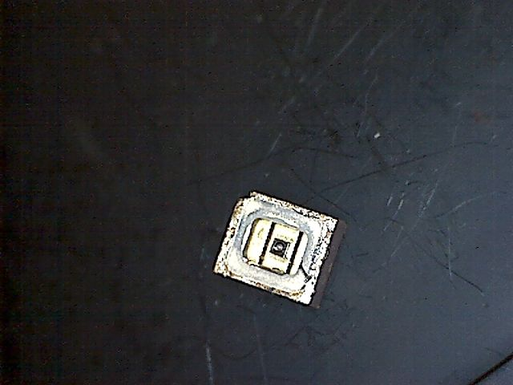
UB Lid Removed

Slide 4
SUMMARY - BACKGROUND
“UB” Packages are one of the smallest semiconductor devices ever subjected to the PIND test
0.12”L x 0.10”W x 0.05”H with internal cavity Height of 0.015”
PIND test at >150 Hz per MIL-STD
Due to small architecture and miniscule cavity, it can be daunting to find loose particles inside

Slide 5
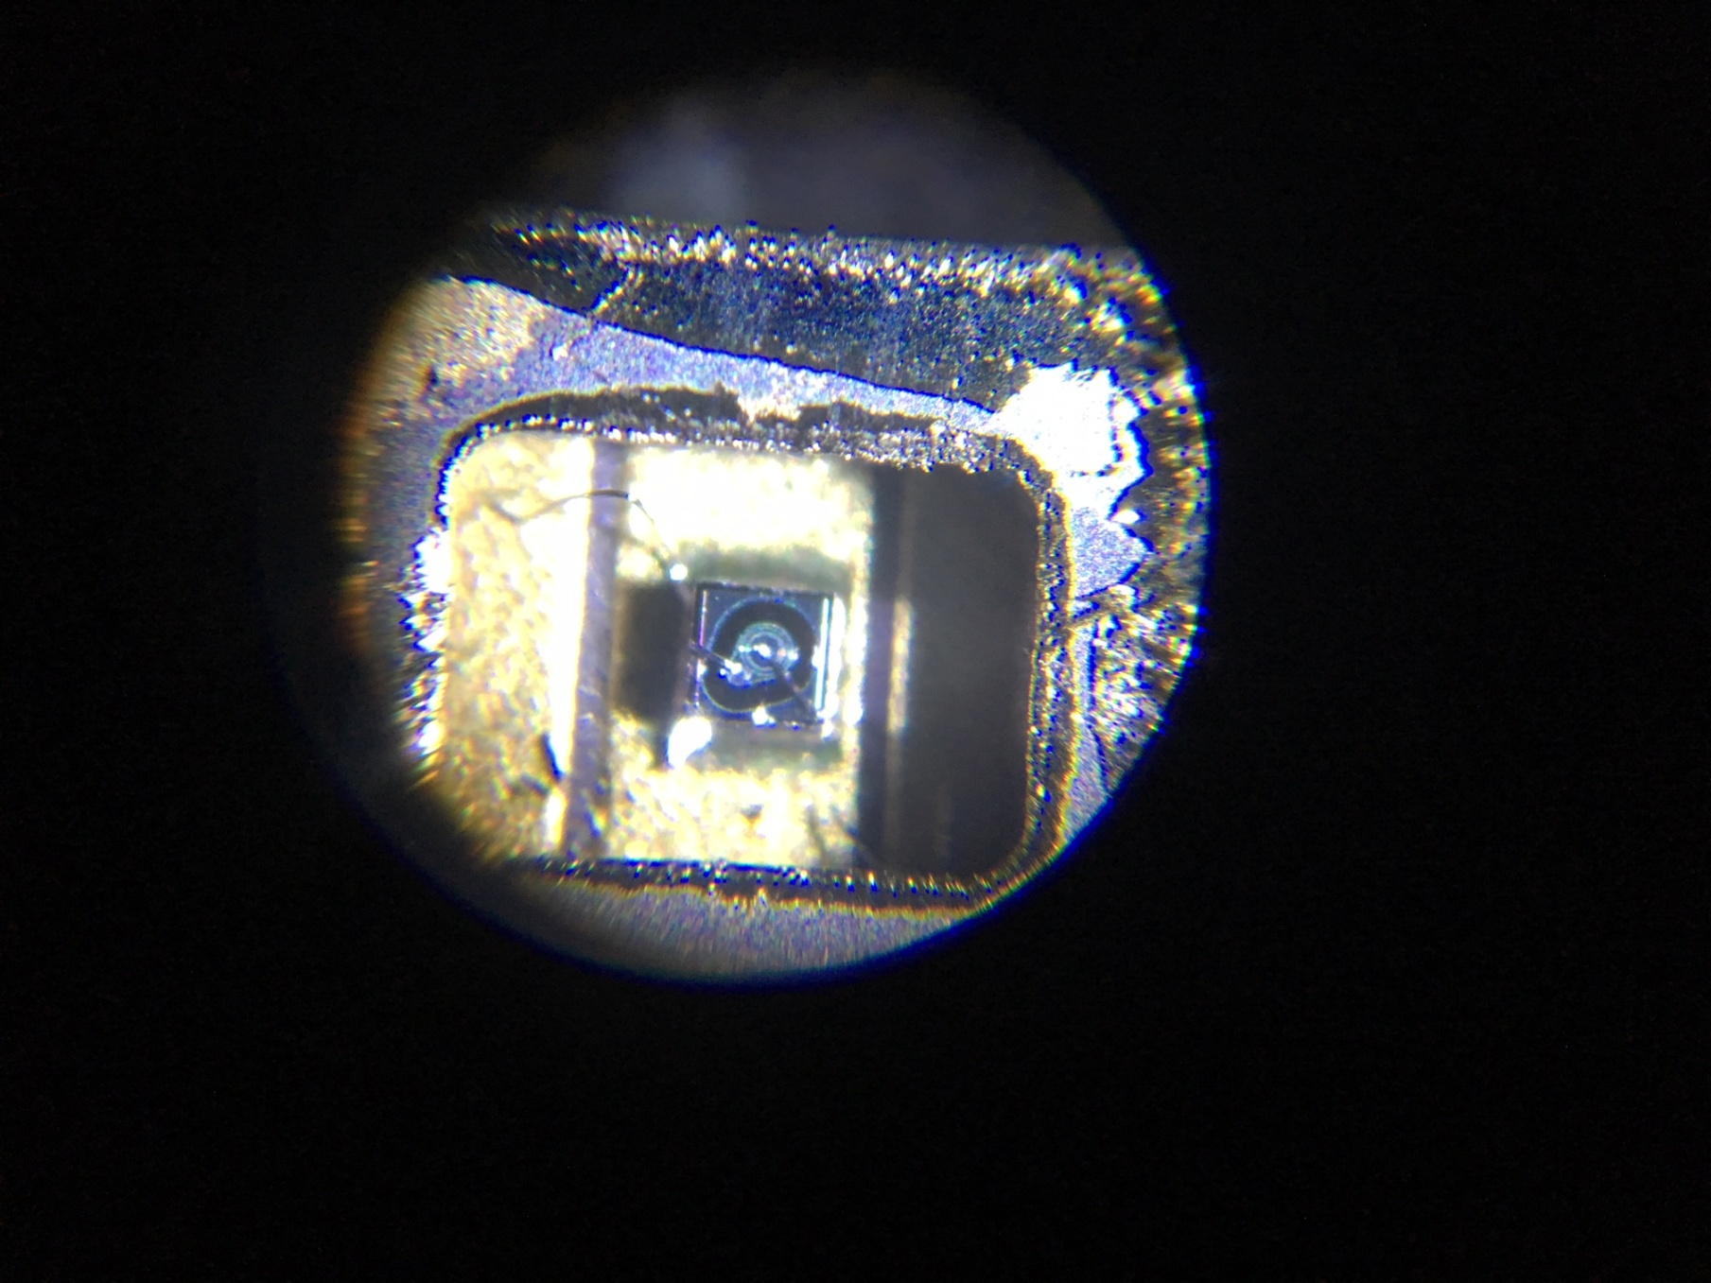
UB X60 Mag

Slide 6
SUMMARY – QUESTIONS POSED
What is the optimal vibration frequency?
130Hz
Does increased mechanical shock improve detection?
No
Does simultaneous shock improve detection?
Yes

Slide 7
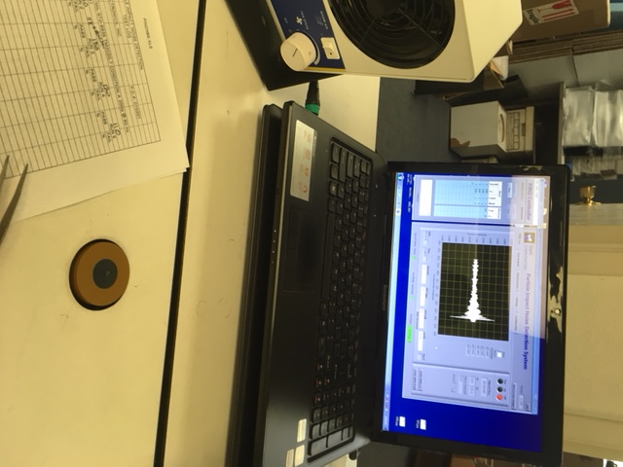
PIND Test Set-up

Slide 8
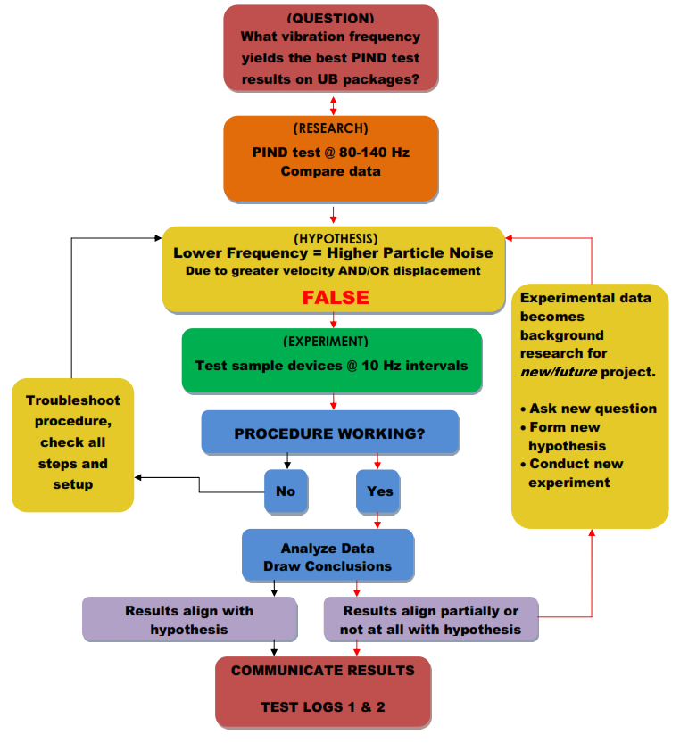
MIL-STD-750 TM 2052 PIND OPTIMIZATION FOR “UB” PACKAGES

Slide 9
Synopsis of Testing
24 UB Packages PIND tested at 80-150Hz vibrations in 10Hz intervals
Packages were divided in two groups: 12 Packages tested in ascending frequency, 12 in descending frequency
After 3 runs (frequencies), the packages were allowed to rest under an ionizing fan for 18 hours.

Slide 12
Synopsis of Testing (Continued)
None of the devices showed a change in Pass/Fail of PIND after 80-150Hz vibration.

Slide 13
Synopsis of Testing
10 UB packages grouped: 5 Fails (low particle noise), 5 pass (no particle noise)
All packages shocked at >5000Gs @ 0.1 ms, then randomized
10 packages retested at 130Hz (highest voltage vs. frequency) with simultaneous and non-simultaneous shock.

Slide 14
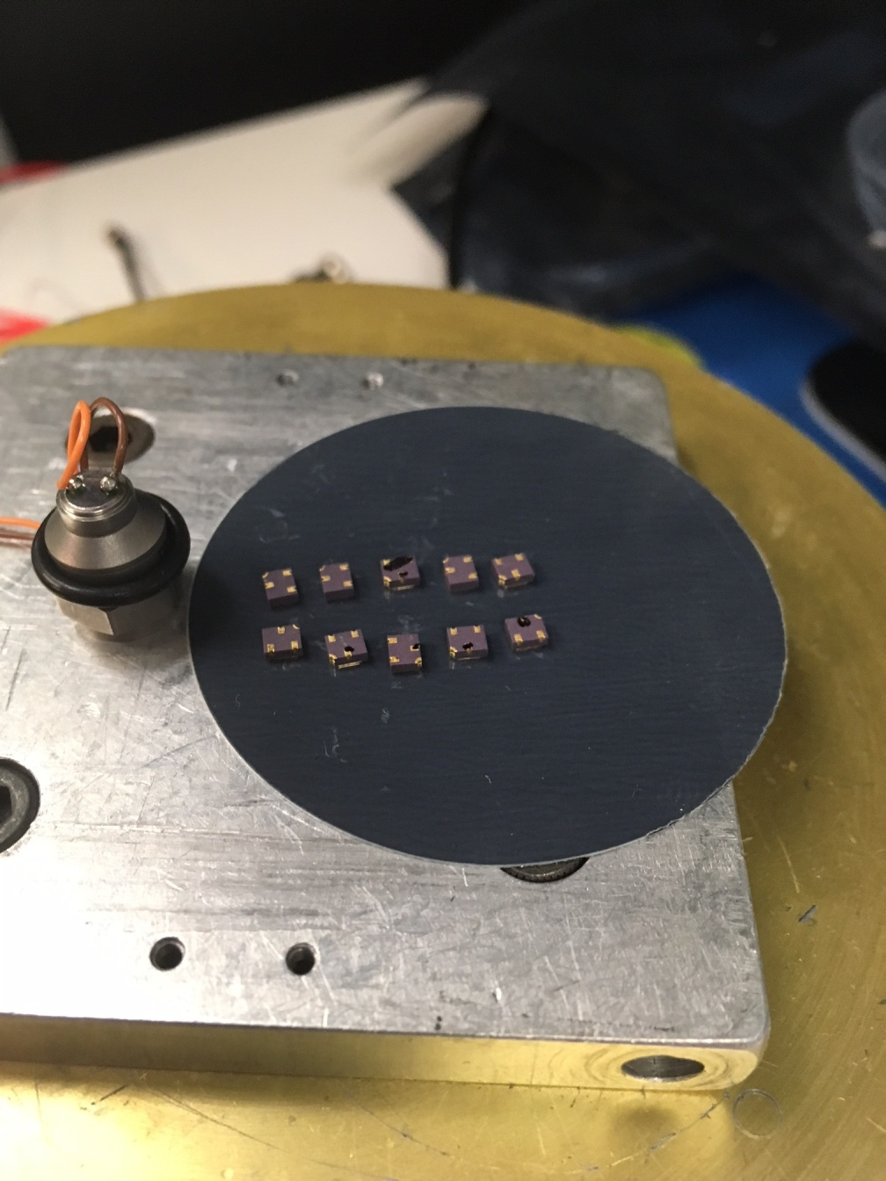
UB Shock

Slide 15
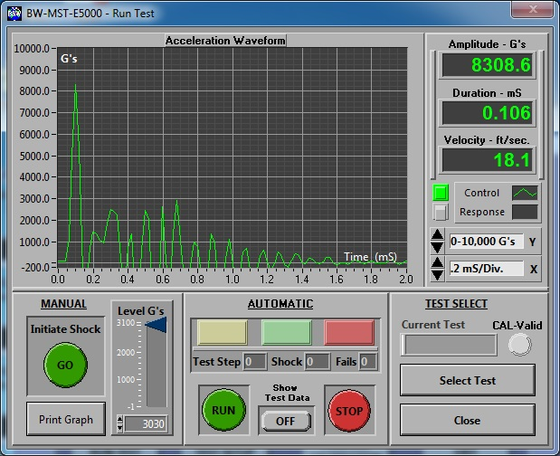
8000Gs @ 0.1 ms

Slide 16
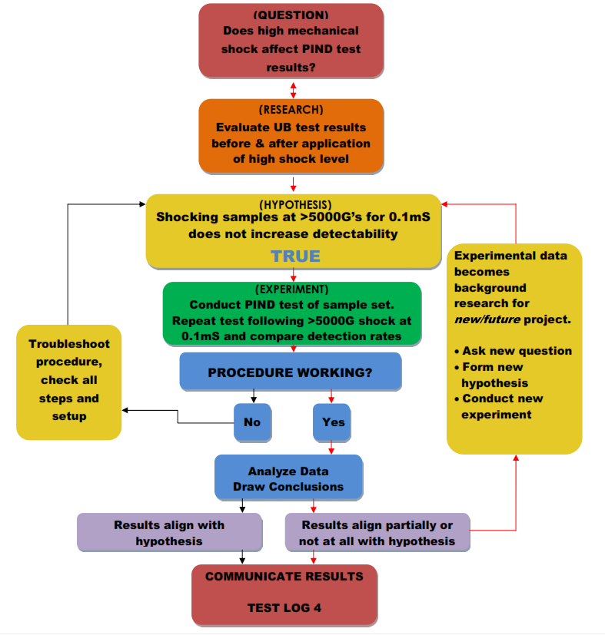
MIL-STD-750 TM 2052 PIND OPTIMIZATION FOR “UB” PACKAGES

Slide 19
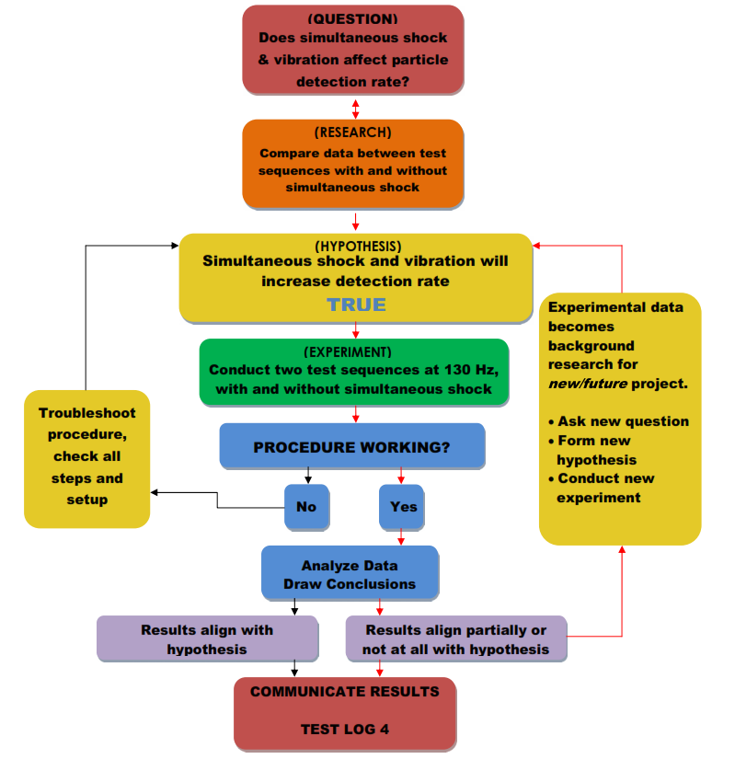
MIL-STD-750 TM 2052 PIND OPTIMIZATION FOR “UB” PACKAGES

Slide 21
Synopsis of Testing (Continued)
Simultaneous shock showed 5 detections (1 below threshold)
Non-simultaneous shock showed only three detections

Slide 22
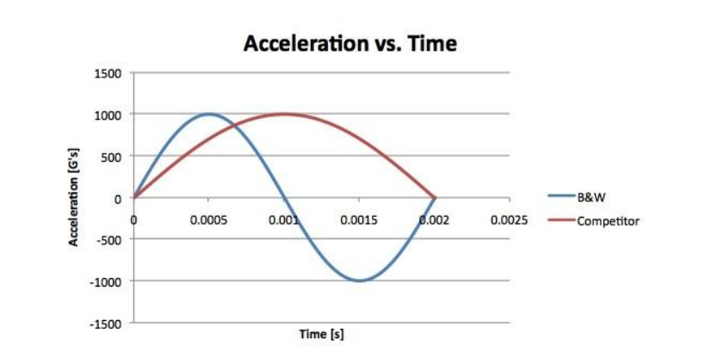
The second law states that the net force on a particle is equal to the time rate of change of its linear momentum p in an inertial reference frame.
Since the law is valid only for constant-mass systems, the mass can be taken outside the differentiation operator by the constant factor rule in differentiation.
Where F is the net force applied, m is the mass of the body, and a is the body’s acceleration. Thus, the net force applied to a body produces a proportional acceleration. In other words, if a body is accelerating, then there is a force on it.

Slide 23
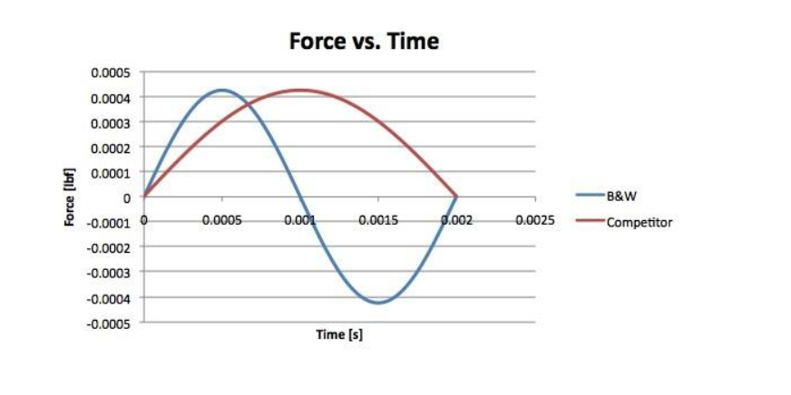
The kinetic energy vs. Force remains constant given the same shock amplitude only over a shorter time period than Force vs. Time.

Slide 24
Impulse
An impulse J occurs when a force F acts over an interval of time Δt and is given by:
Since force is the time derivative of momentum, it follows that:
This relation between impulse and momentum is closer to Newton’s wording of the second law. Impulse is a concept frequently used in the analysis of collisions and impacts.

Slide 25
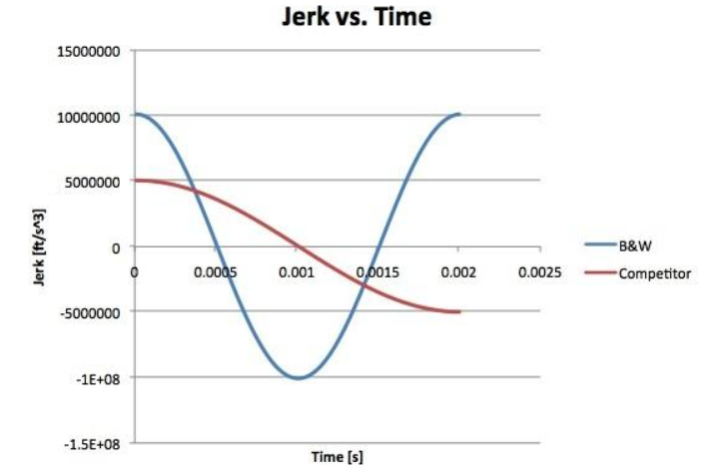
This graph compares acceleration change over a short time. As the time decreases, the velocity change over time increases by a factor of 2, 10,000,000 ft/s³ @ 50 microseconds vs. 5,000,000 ft/s³ @ 100 microseconds.

Slide 26
Summary
These graphs show that the shorter duration reduces the energy applied (safer) while maintaining equal amplitude. A shorter duration shock is both more effective at knocking particles loose (due to the high resonant frequency of the particles) while reducing the stress applied to the device and avoiding possible unintended consequences of micro-cracks or other latent failures caused by mechanical shock, a major source of failure for some devices, especially delicate MEMS, crystal oscillators, implantable medical devices, etc. Shocking these devices at 40% of design maximum 16 times per PIND test up to 5 times for a possible total of 80 shocks is clearly an unnecessary risk.
The current proposal to lengthen the shock pulse duration should be denied on the grounds that it does not improve PIND detection and may cause damage.

Slide 27
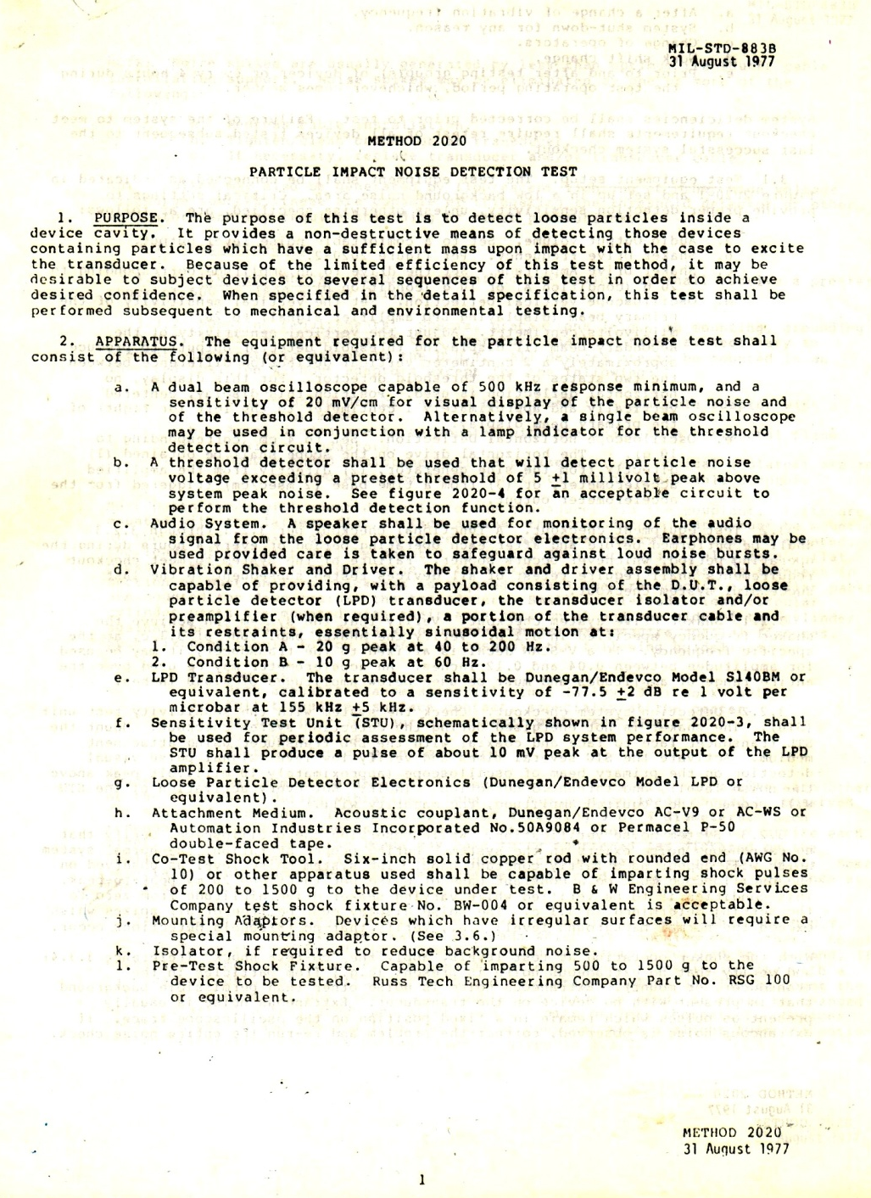
The original PIND test standard did not allow any interruption in the vibration during shocks.
The shock was applied with a #10 solid copper rod until B&W created and patented a PIND true co-test shock mechanism, the BW-004 which has the highest detection score of any PIND.
The “perturbed” shaker-shock was proved to be less effective than even the copper rod in the NBS PIND study NBSIR 78-1590.

Slide 28
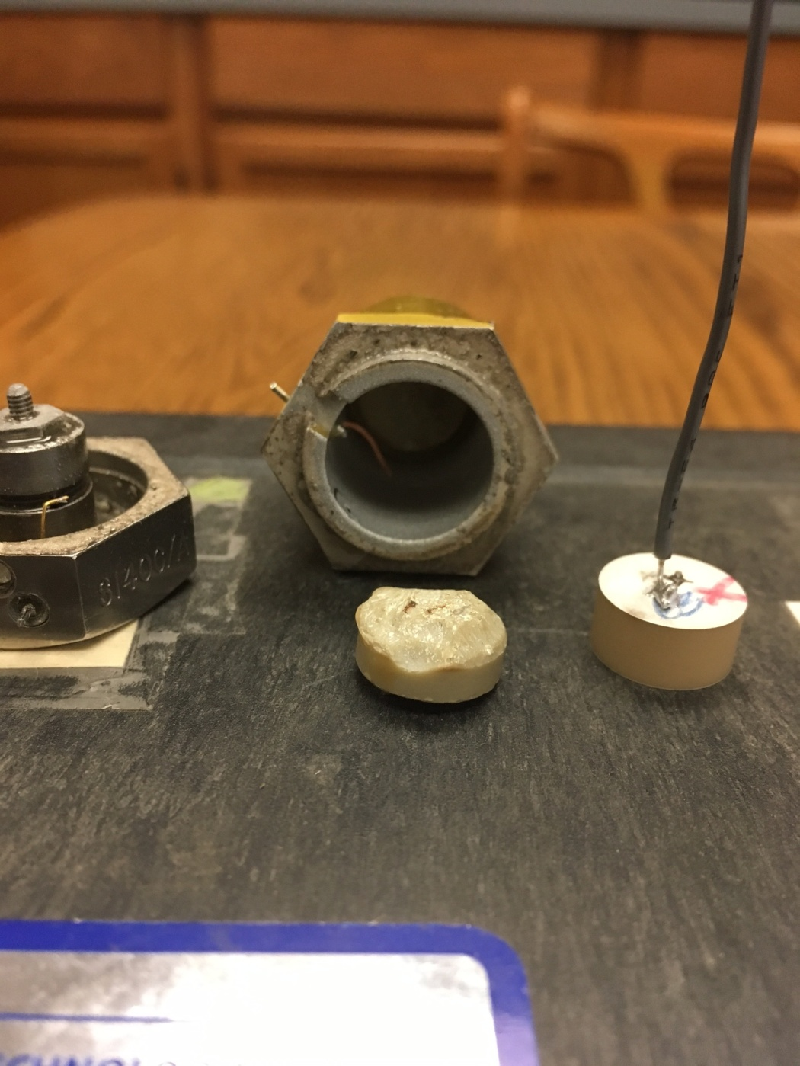
Micro-cracking
Effect of cumulative shocks on the PZT-5 (PIND sensors)
Center = competitor’s sensor after cumulative shocks. Shell (behind) and accelerometer (left).
Right = B&W PIND Sensor
(micro-cracking never observed in over 40 years of manufacture)

